Slide 1
Password Generator
Password Generator project in Python using Tkinter for the graphical user interface(GUI)

Slide 2
Here’s a simple Password Generator project in Python using Tkinter for the graphical user interface(GUI) that generates a random password with a mix of uppercase, lowercase letters, digits and special characters.
Explanation:
Password Generator:
Generate_password(): Generates a random password with a length specified by the user.
The password is created using ascii_letters, digits and punctuation from the string module which includes uppercase, lowercase letters, number and symbols.
The generated passwords is added to the Listbox for display.
2. Clearing the Listbox:
Clear_passwords(): Clears all the passwords from the Listbox.
3. Tkinter GUI:
Entry field to accept password length.
Buttons for generating and clearing passwords.
A Listbox to display multiple generated passwords.

Slide 3
Features:
Password Length: The user can specify the length of the password.
Multiple Passwords: Multiple passwords can be generated and viewed in the Listbox.
Clear List: The “Clear List” button clears all the generated passwords from the list.

Slide 4
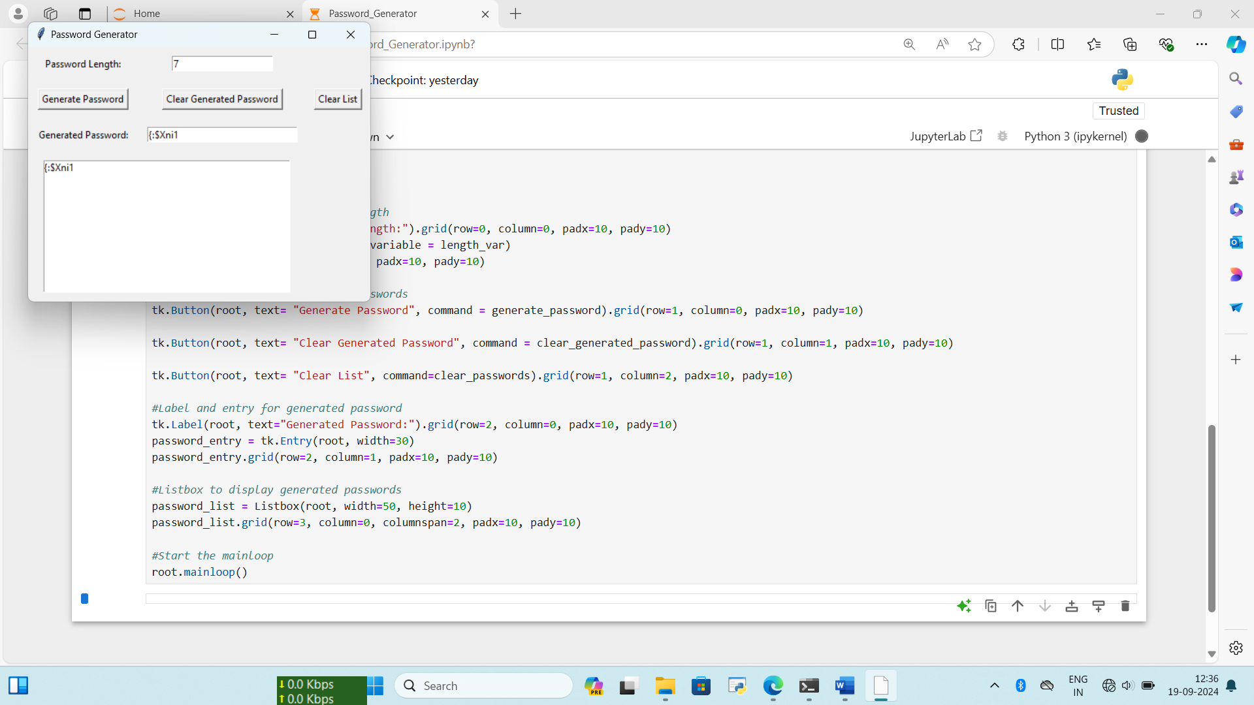
Example of Output:

Slide 5
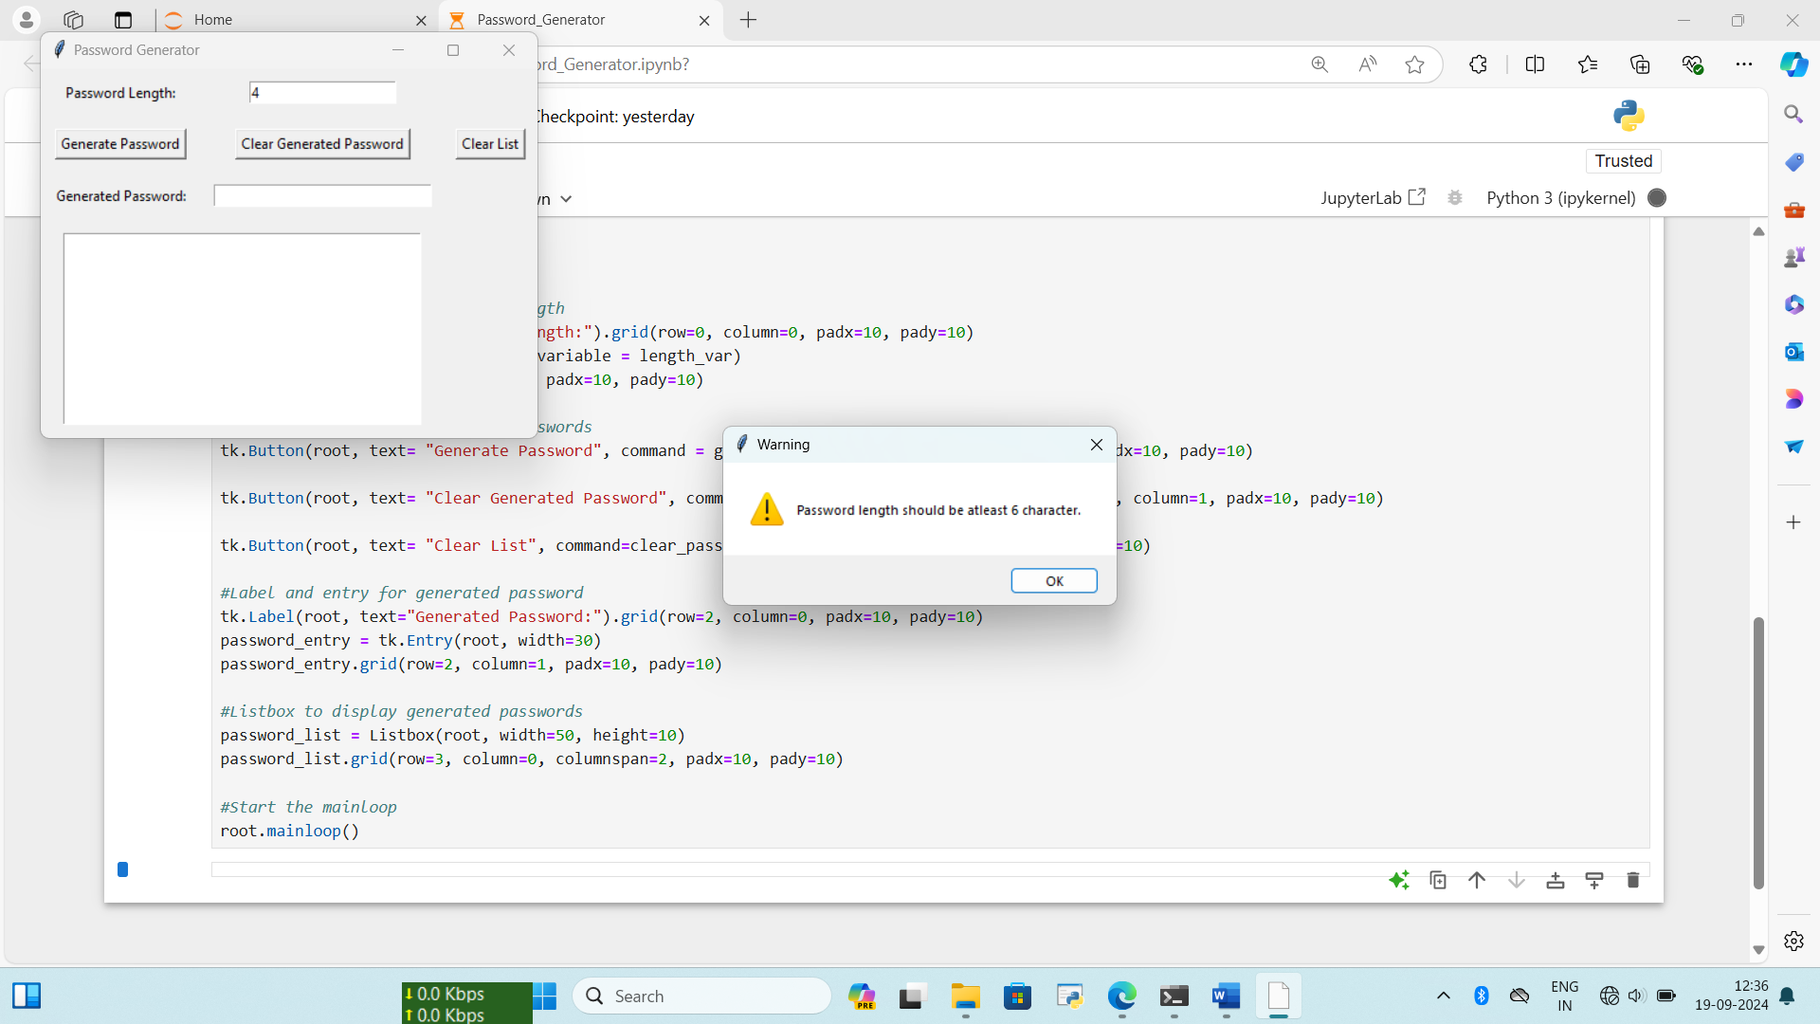
This simple password generator ensures a strong and secure password is created based on the length specified by the user.

